Slide 1
Solid state NMR
CHEM 3013 HPO lecture 2

Slide 2
Overview
Lecture 1: Anisotropic spin interactions
Lecture 2:
Solids spectra and magic angle spinning
NMR experiments for biosolids
Practical:
Tuning the magic angle with quadrupolar ⁷⁹Br
Cross-polarisation with a adamantane

Slide 3
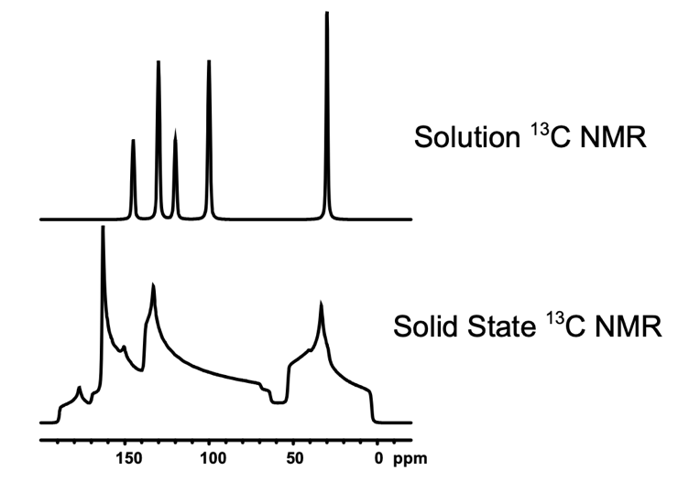
Review: anisotropic interactions
CSA
Tensor formalism
Uninterpretable spectra
Direct DD coupling

Slide 4
Spinning solids
Random molecular tumbling in solution removes anisotropic spin interactions leaving narrow lines.
We can physically rotate a solid sample to achieve a similar effect as tumbling in solution.
What axis orientation leads to the best averaging?

Slide 5
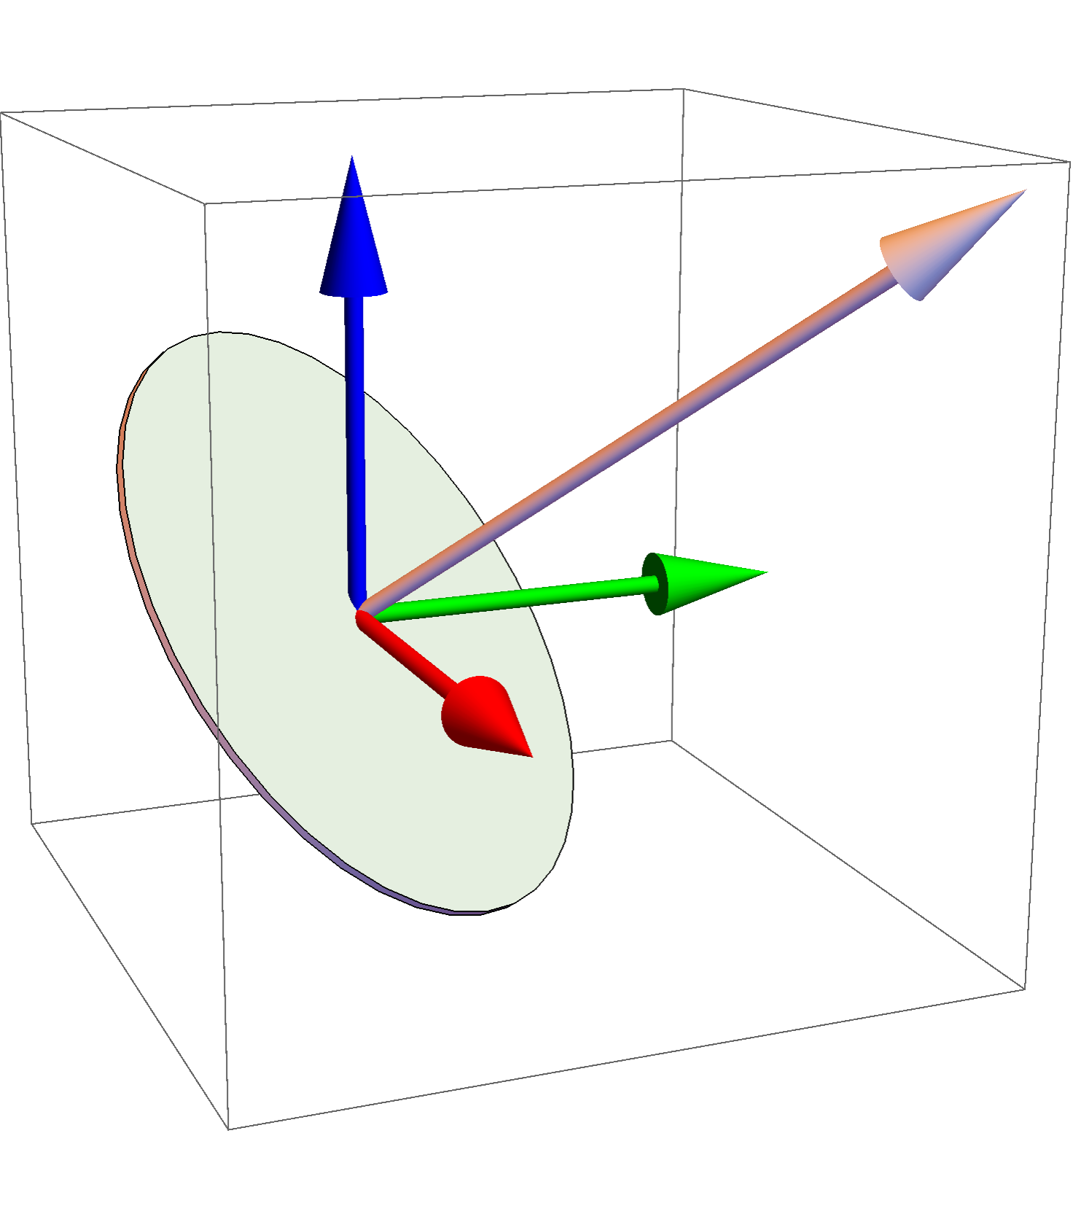
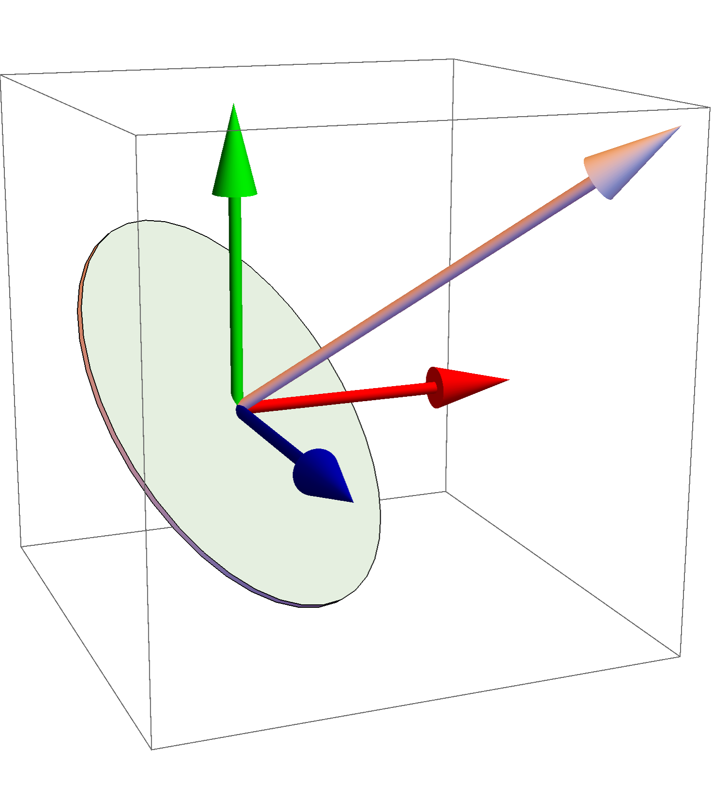
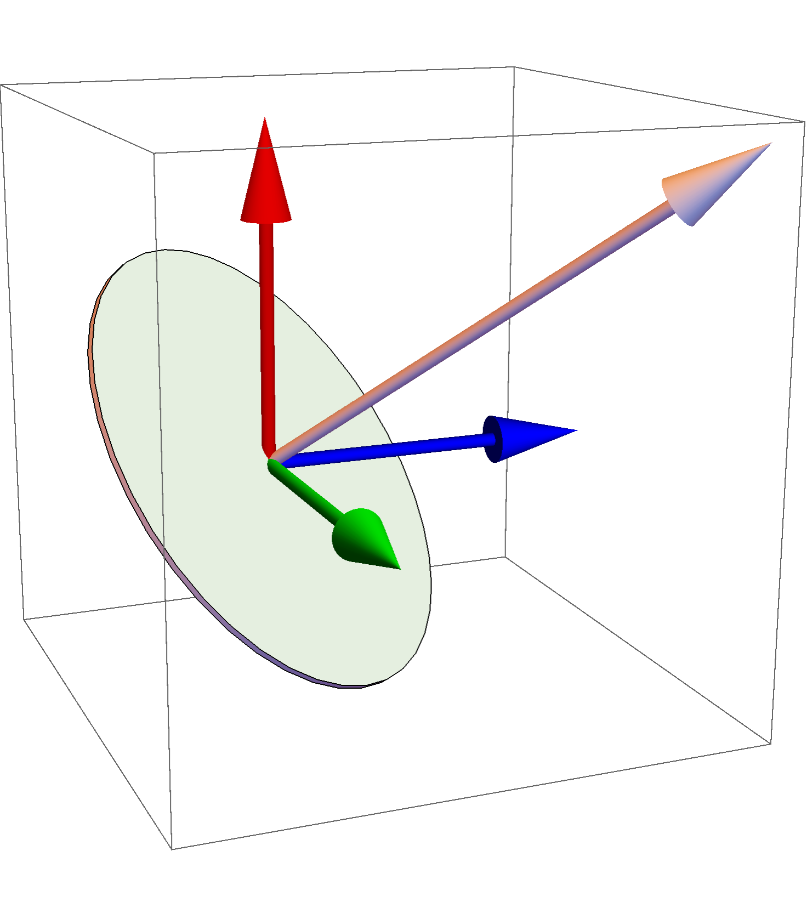
The magic angle: 54.7°

Slide 6
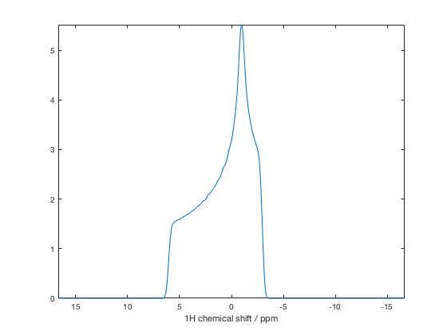
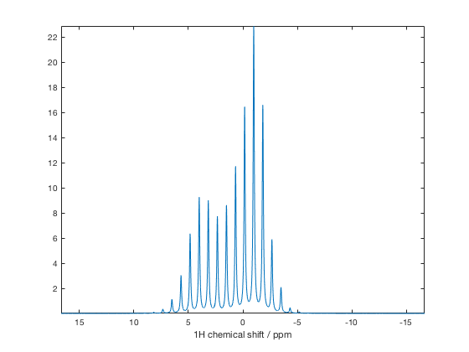
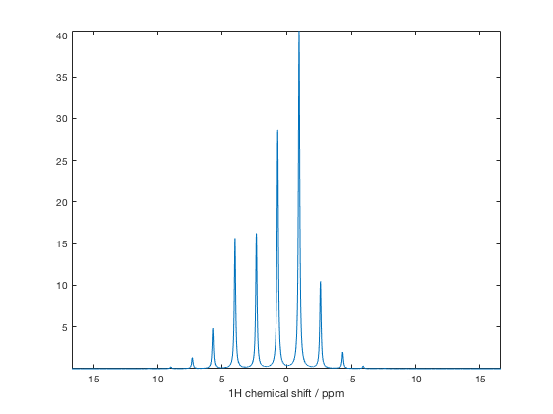
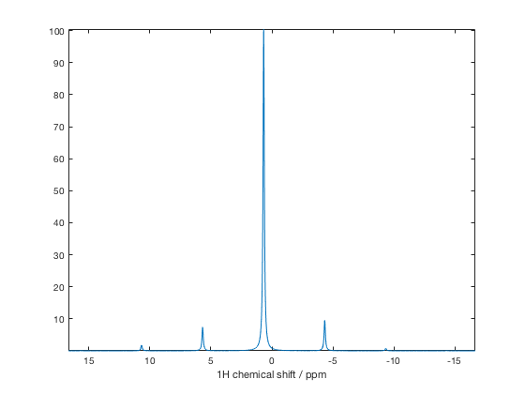
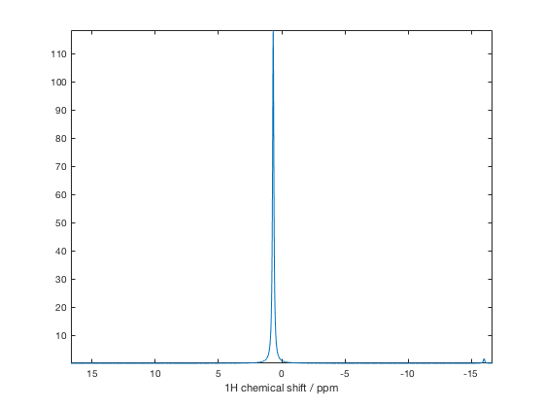
Static
500 Hz MAS
1 kHz MAS
3 kHz MAS
10 kHz MAS
Single 1H spin:
600 MHz
δ_{xx} = -3
δ_{yy} = -1
δ_{zz} = 6
δ_{iso} = 0.67 ppm

Slide 7
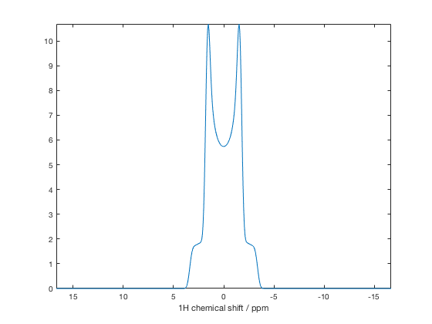
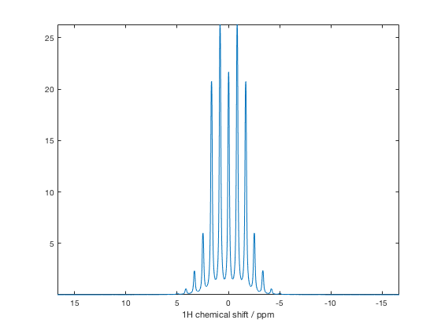
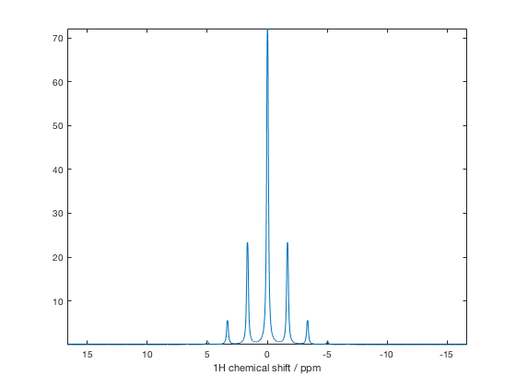
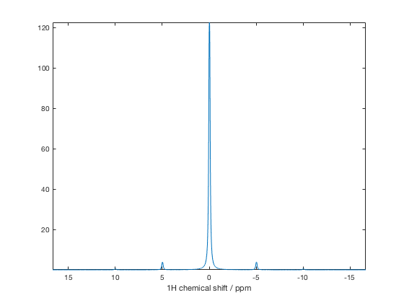
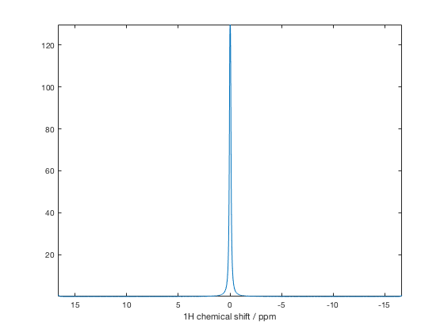
Static
500 Hz MAS
1 kHz MAS
3 kHz MAS
10 kHz MAS
1H-1H spin pair
At 0 ppm and 100 ppm
600 MHz
3.8 Å separation

Slide 8
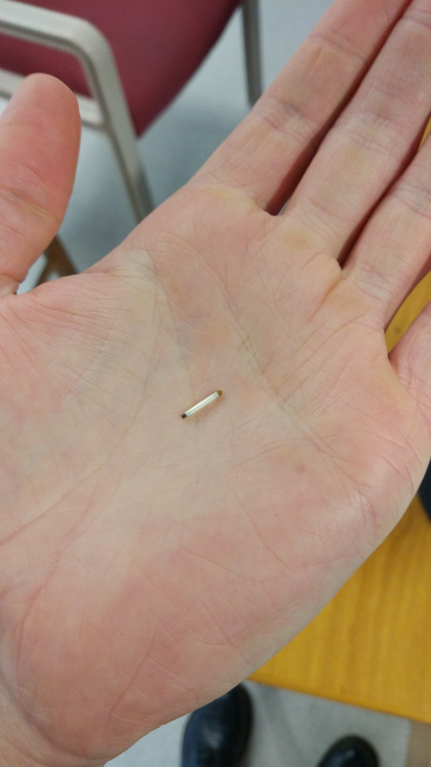
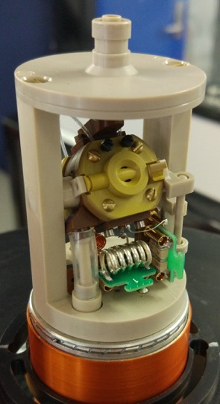
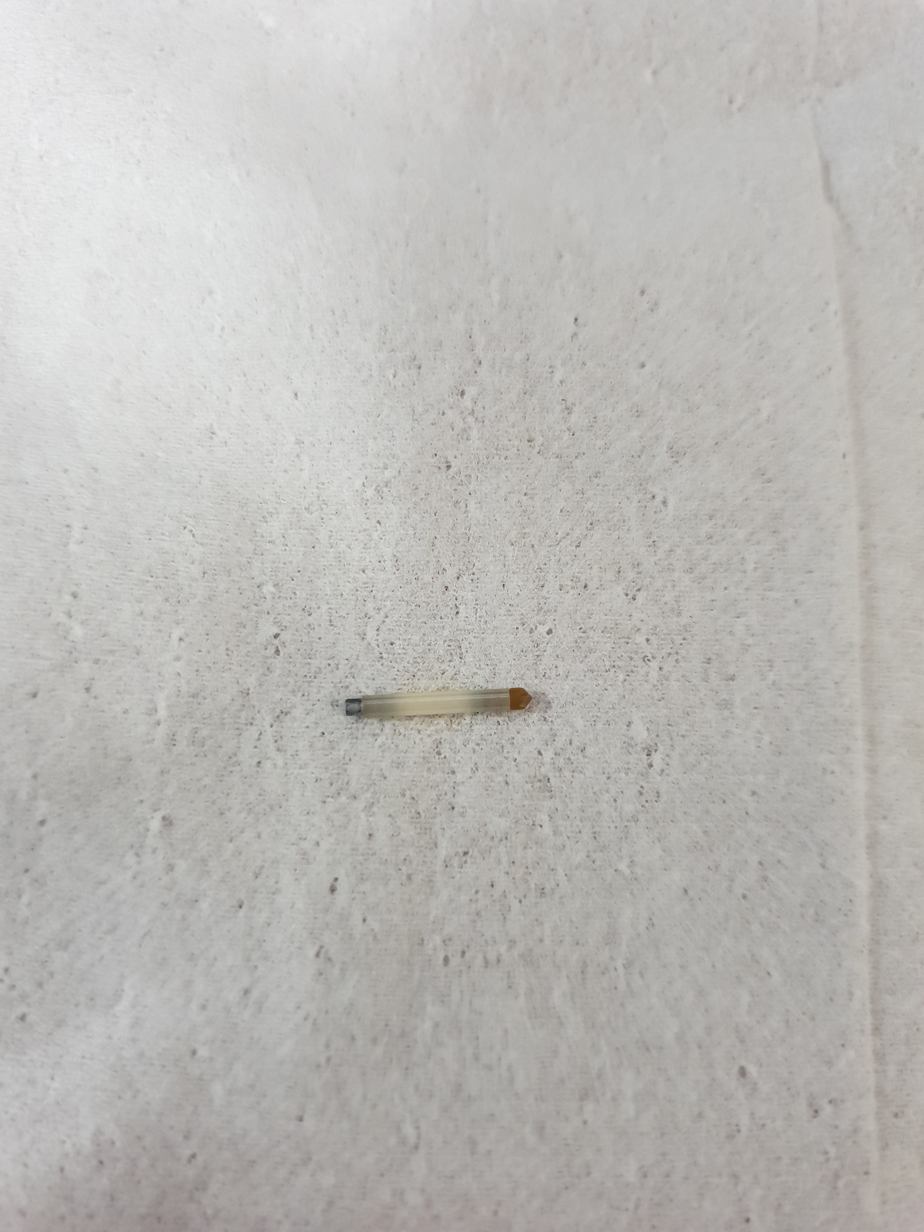
The solid state NMR probe

Slide 9
Rotor diameter and spinning speed
0.5
67 kHz
170 kHz

Slide 10
Making NMR experiments in solids state
Magic angle spinning (MAS) efficiently removes CSA and DD coupling.
How can we transfer magnetisation for correlation spectroscopy?
RF pulses synchronised with the MAS frequency can reintroduce anisotropic interactions.

Slide 11
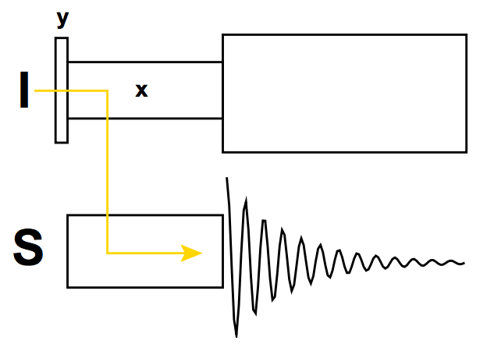
Magnetisation transfer for correlation spectroscopy
INEPT – Solution state
CP/MAS – Solid state
J-coupling
Direct DD coupling

Slide 12
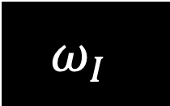

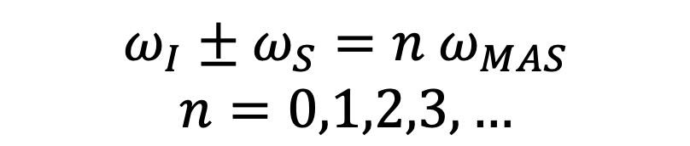

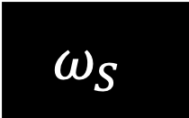
Basic CP experiment (like HSQC)
$$ω_{I}$$
$$ω_{I}$$
I
t₁
$$ω_{S}$$
$$ω_{S}$$
S
$$ω_{I}±ω_{S}=n ω_{MAS}$$
$$n=0,1,2,3,…$$

Slide 13
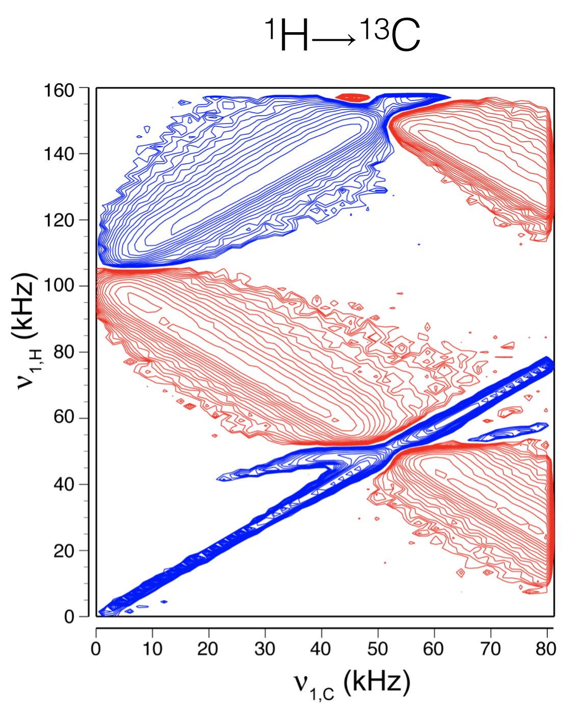
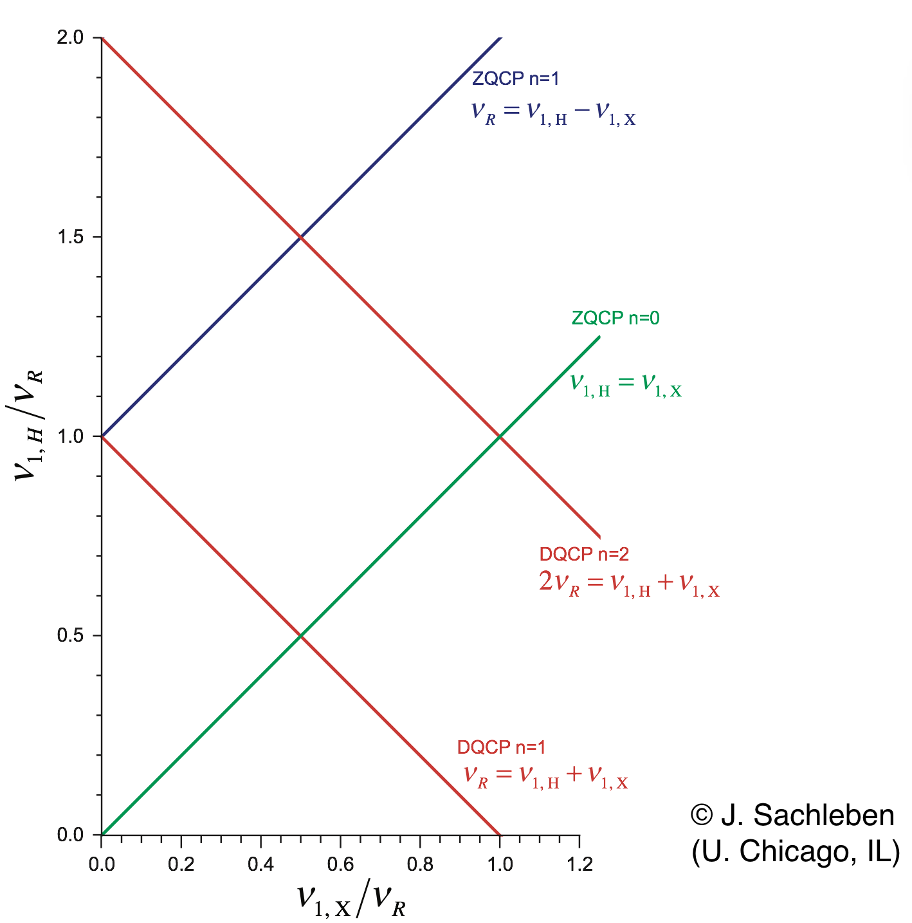
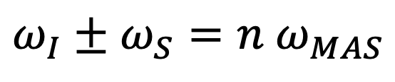
Cross-polarisation conditions at 105 kHz MAS
$$ω_{I}±ω_{S}=n ω_{MAS}$$

Slide 14
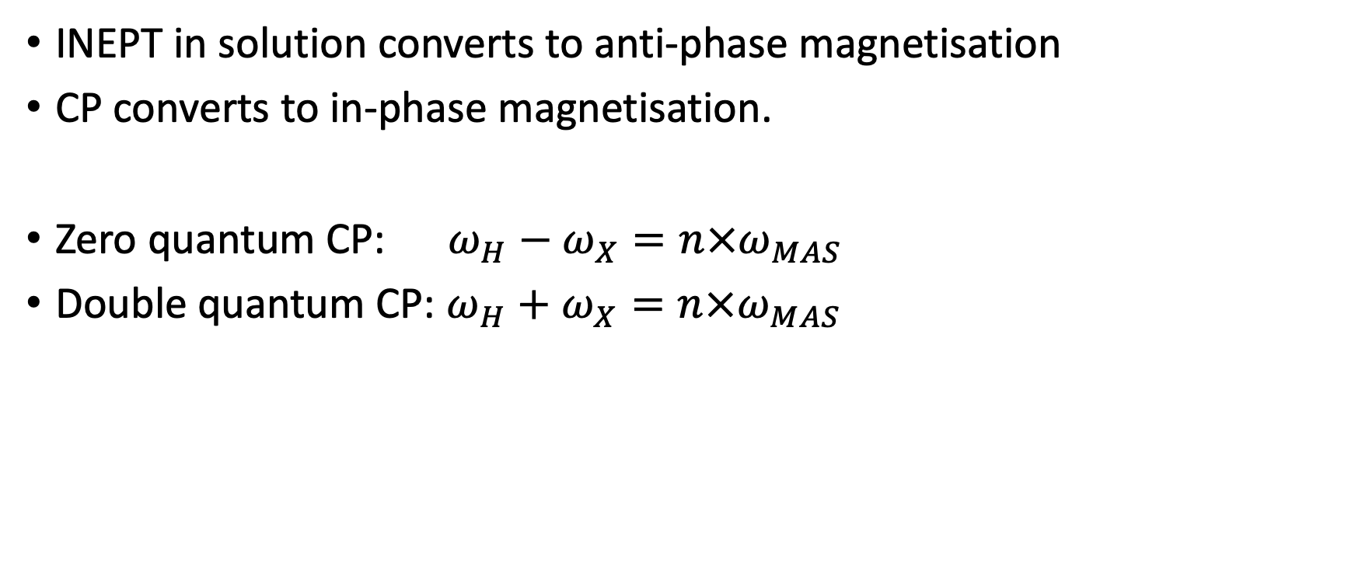
CP phase and conditions
INEPT in solution converts to anti-phase magnetisation
CP converts to in-phase magnetisation.
Zero quantum CP: $ω_{H}−ω_{X}=n×ω_{MAS}$
Double quantum CP: $ω_{H}+ω_{X}=n×ω_{MAS}$

Slide 15
Example CP condition for HN experiment
MAS = 60 kHz
1H RF power = 80 kHz
What 15N power is required for DQ condition?
What 15N power is required for ZQ condition?

Slide 16
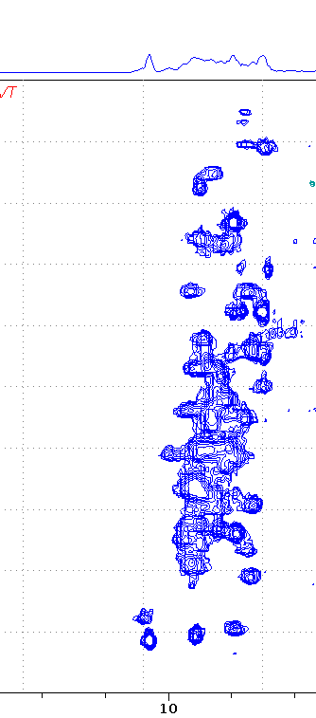


HN CP experiment
$$ω_{I}$$
supp.
$$ω_{I}$$
H
t₁
$$ω_{S}$$
$$ω_{S}$$
N
dec.

Slide 17
Line width and proton detection in solids
 | 1H | Heteronuclei: 13C, 15N
Abundance | High | Low
Direct DD coupling | Large | Small
Inhomogenous broadening | Large | Small
Sensitivity | High | Low
Required MAS rate | >100 kHz | 40 kHz
Partial deuteration of a protein reduces 1H-1H dipolar broadening, giving narrower lines

Slide 18
Preparing a solid protein sample
If molecules are static and homogenous, they will give a great spectrum.
Solid state NMR is not limited by molecular size (MDa virus assemblies and fibrils are no problem)

Slide 19
Micro-crystalline samples
Static?
YES: Molecules in a crystal are locked in a single orientation.
Homogenous?
YES: Crystal unit cell contacts are the same for all molecules, giving the same environment.

Slide 20
Precipitated samples
Static?
YES: Molecules are locked in a single orientation by their neighbours
Homogenous?
NO: The amorphous environment means the sample is inhomogenous. This will give broad peaks.

Slide 21
Frozen samples
Static?
YES: Molecules are immobilised by solid water molecules
Homogenous?
NO PROBABLY: The crystalline structure of water varies and can introduce inhomogeneities. Freezing crystalline samples will distort the crystal lattice. This gives broad peaks.

Slide 22
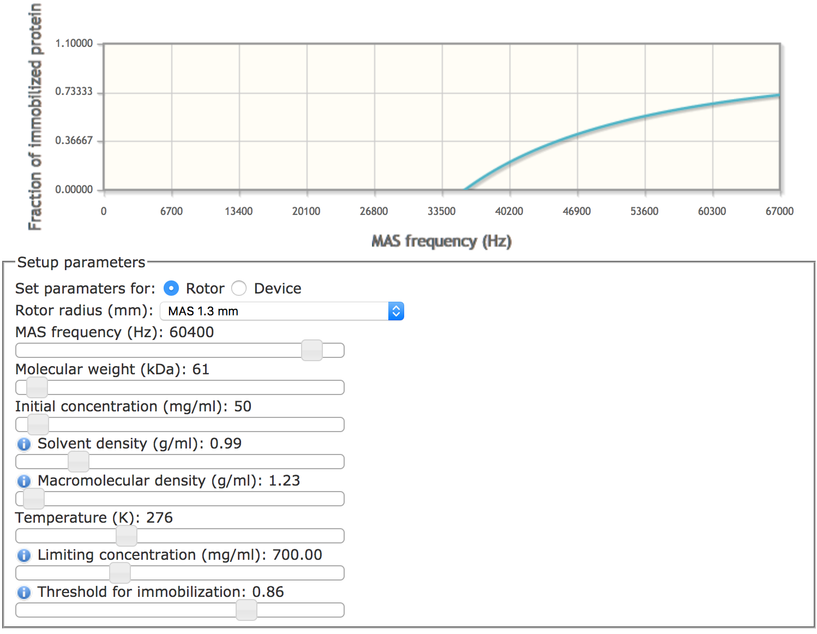
Sedimented samples
Static?
YES: Molecules are locked in a single orientation by extreme G-force (~100 million ms⁻²)
Homogenous?
YES: Not sure why
http://py-enmr.cerm.unifi.it/access/index/sednmr

Slide 23
Lipid samples
Static?
YES: Molecules are locked in a single orientation by surrounding lipid bilayer
AND NO: Loop regions may not be visible as they are dynamic
Homogenous?
Yes: The lipids isolate proteins and appear homogenous.

Slide 24
Summary
Magic angle spinning removes anisotropic spin interactions
Rotor synchronised RF pulses reintroduce direct DD coupling allowing magnetisation transfer
Biosolids must be static and homogenous to give desirable spectra.
henry.orton@anu.edu.au

Slide 25
1/4J
1/4J
1/4J
1/4J
supp.
H
t₁
N
dec.

